Slide 1
AI+BD ML Lab. Day 4
March 25th, 2021
Convolutional Neural Network (CNN)
Jio Gim <jio.gim@postech.edu>

Slide 2
Today’s Goals
“CNN”
Create CNN model with CAM
Learn CIFAR-10 data with your model
Watch your CAM

Slide 3
Goals
Understanding basic components of CNN
Composing a CNN model and test it with CIFAR-10 dataset
Watching Class Activation Map using CNN

Slide 4
Backgrounds
For your information & reminding

Slide 5
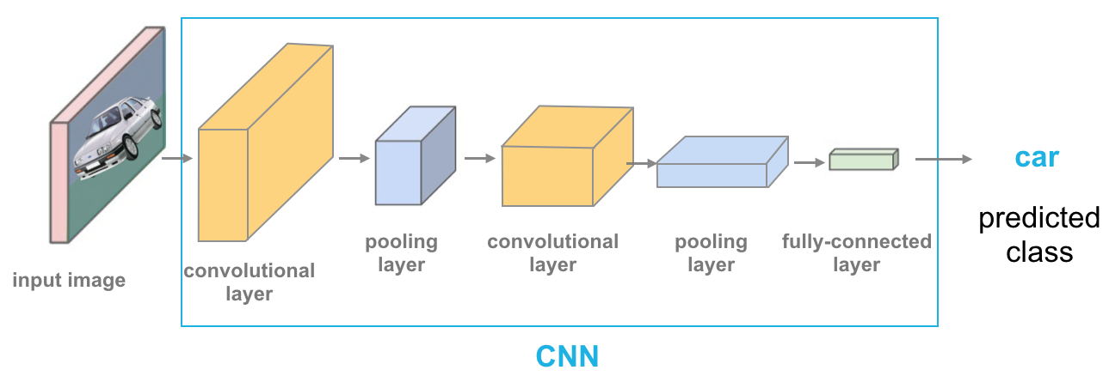
Convolutional Neural Network
A good network for image

Slide 6
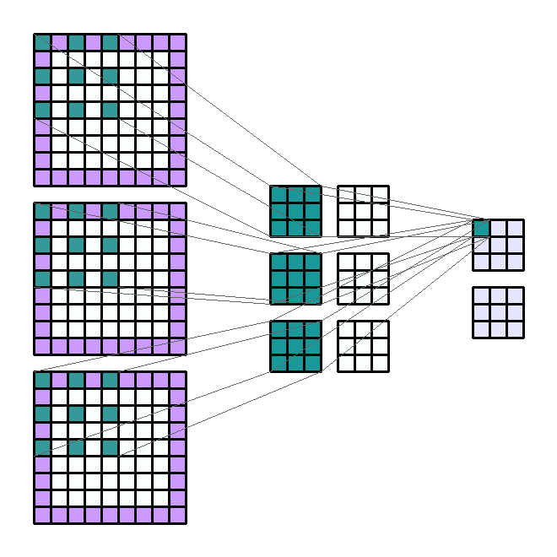
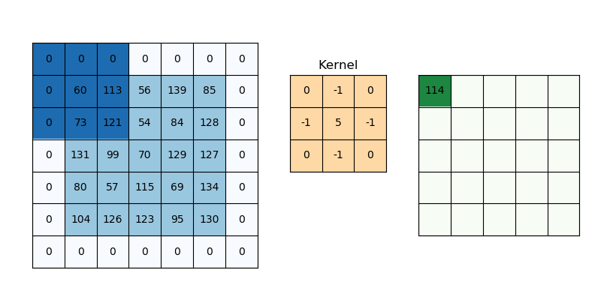
Components of CNN
Convolution Operation (Conv2d)

Slide 7
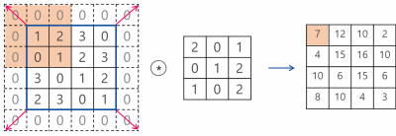
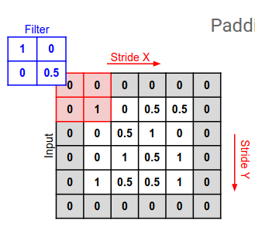
Components of CNN
Convolution Operation (Conv2d) – Stride, Padding

Slide 8

Components of CNN
Max-pooling (MaxPool2d)

Slide 9
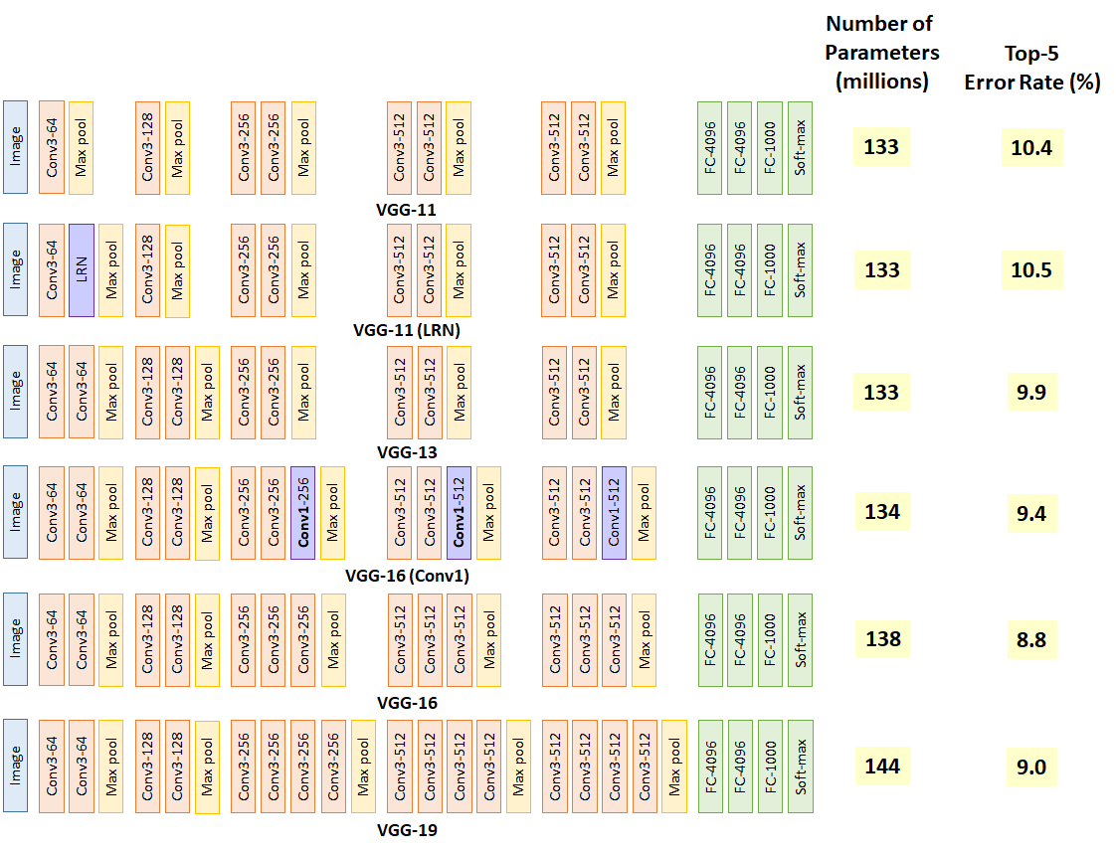

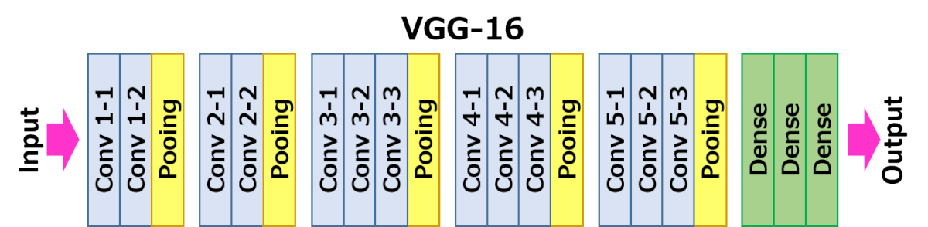
Famous CNNs
VGG11-19

Slide 10
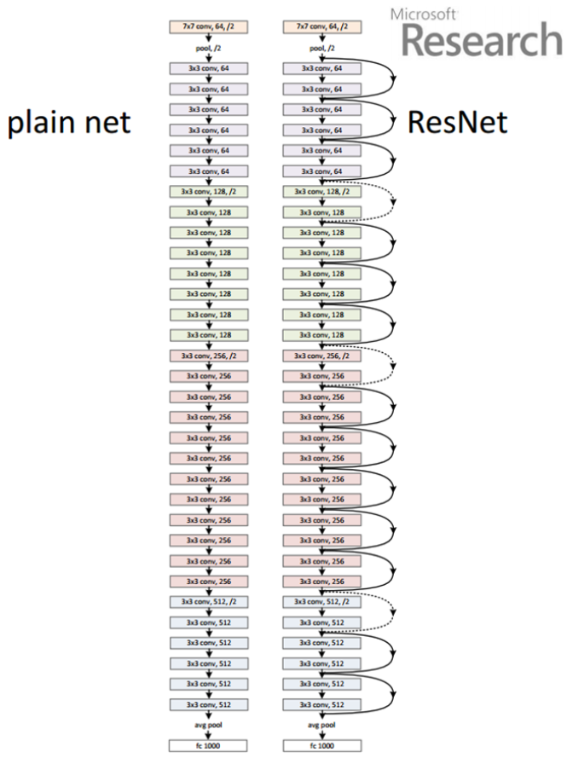
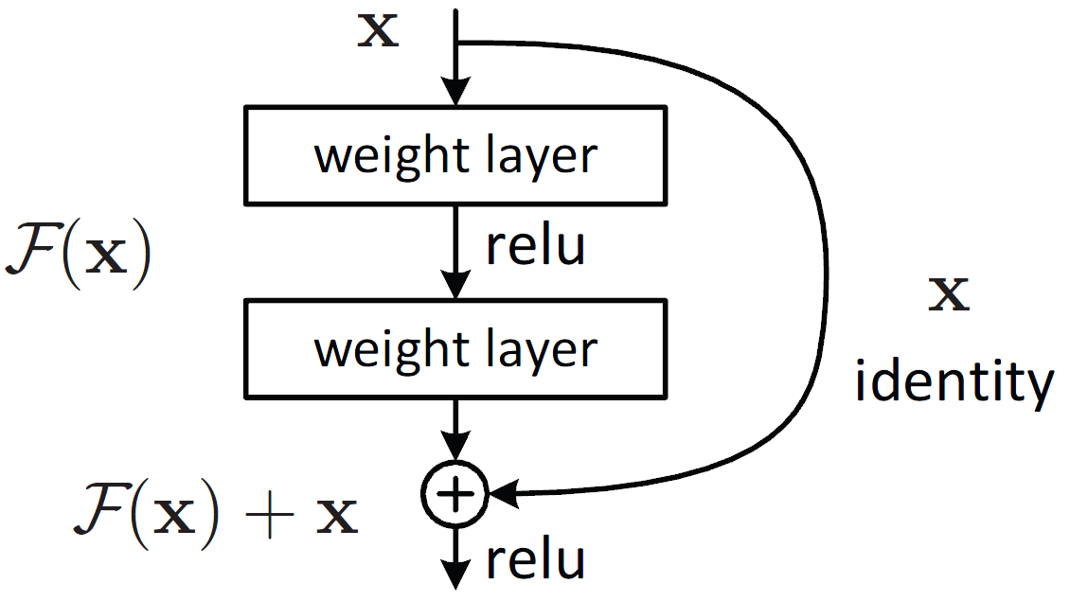
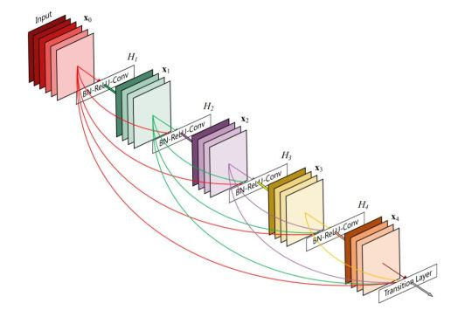
Famous CNNs
ResNet

Slide 11
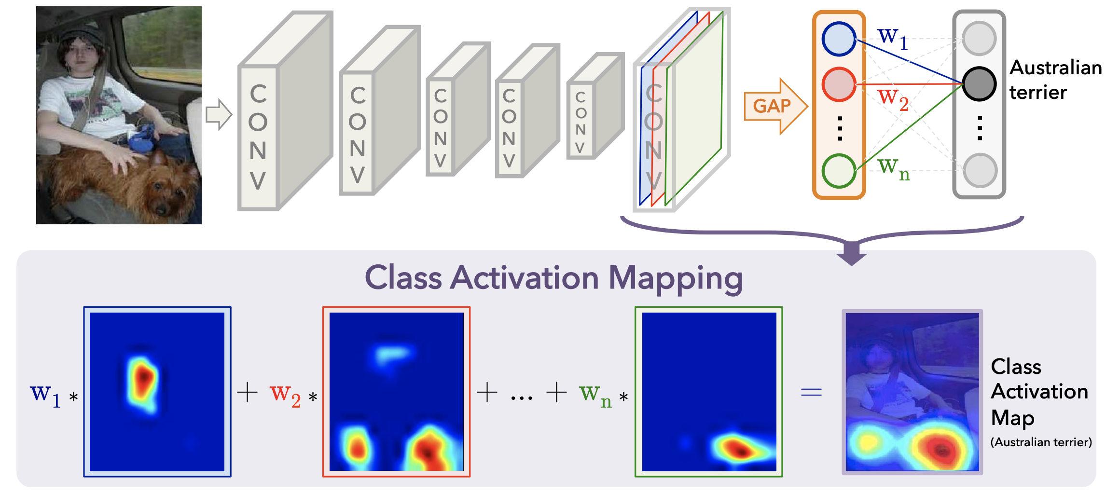
Class Activation Map

Slide 12
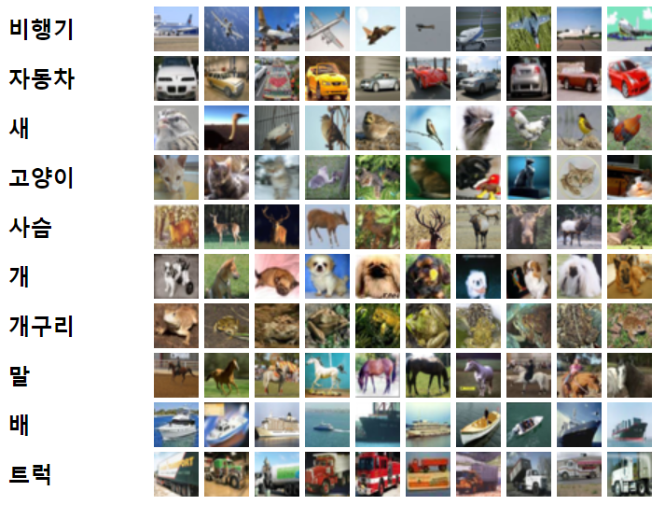
CIFAR 10 Dataset
10 classification dataset by Canadian Institute For Advanced Research
32X32 RGB image
50000 training data pairs
10000 test data pairs
Today we will upscale this 32x32 image to 224x224 RGB image

Slide 13
It’s coding time
Let’s fill the I.P.Y.N.B

Slide 14
Preparation
Base .ipynb :
https://git.io/aibd-py-4
Required Python Packages :
matplotlib numpy scikit-learn scikit-image
torch torchvision torchsummary

Slide 15
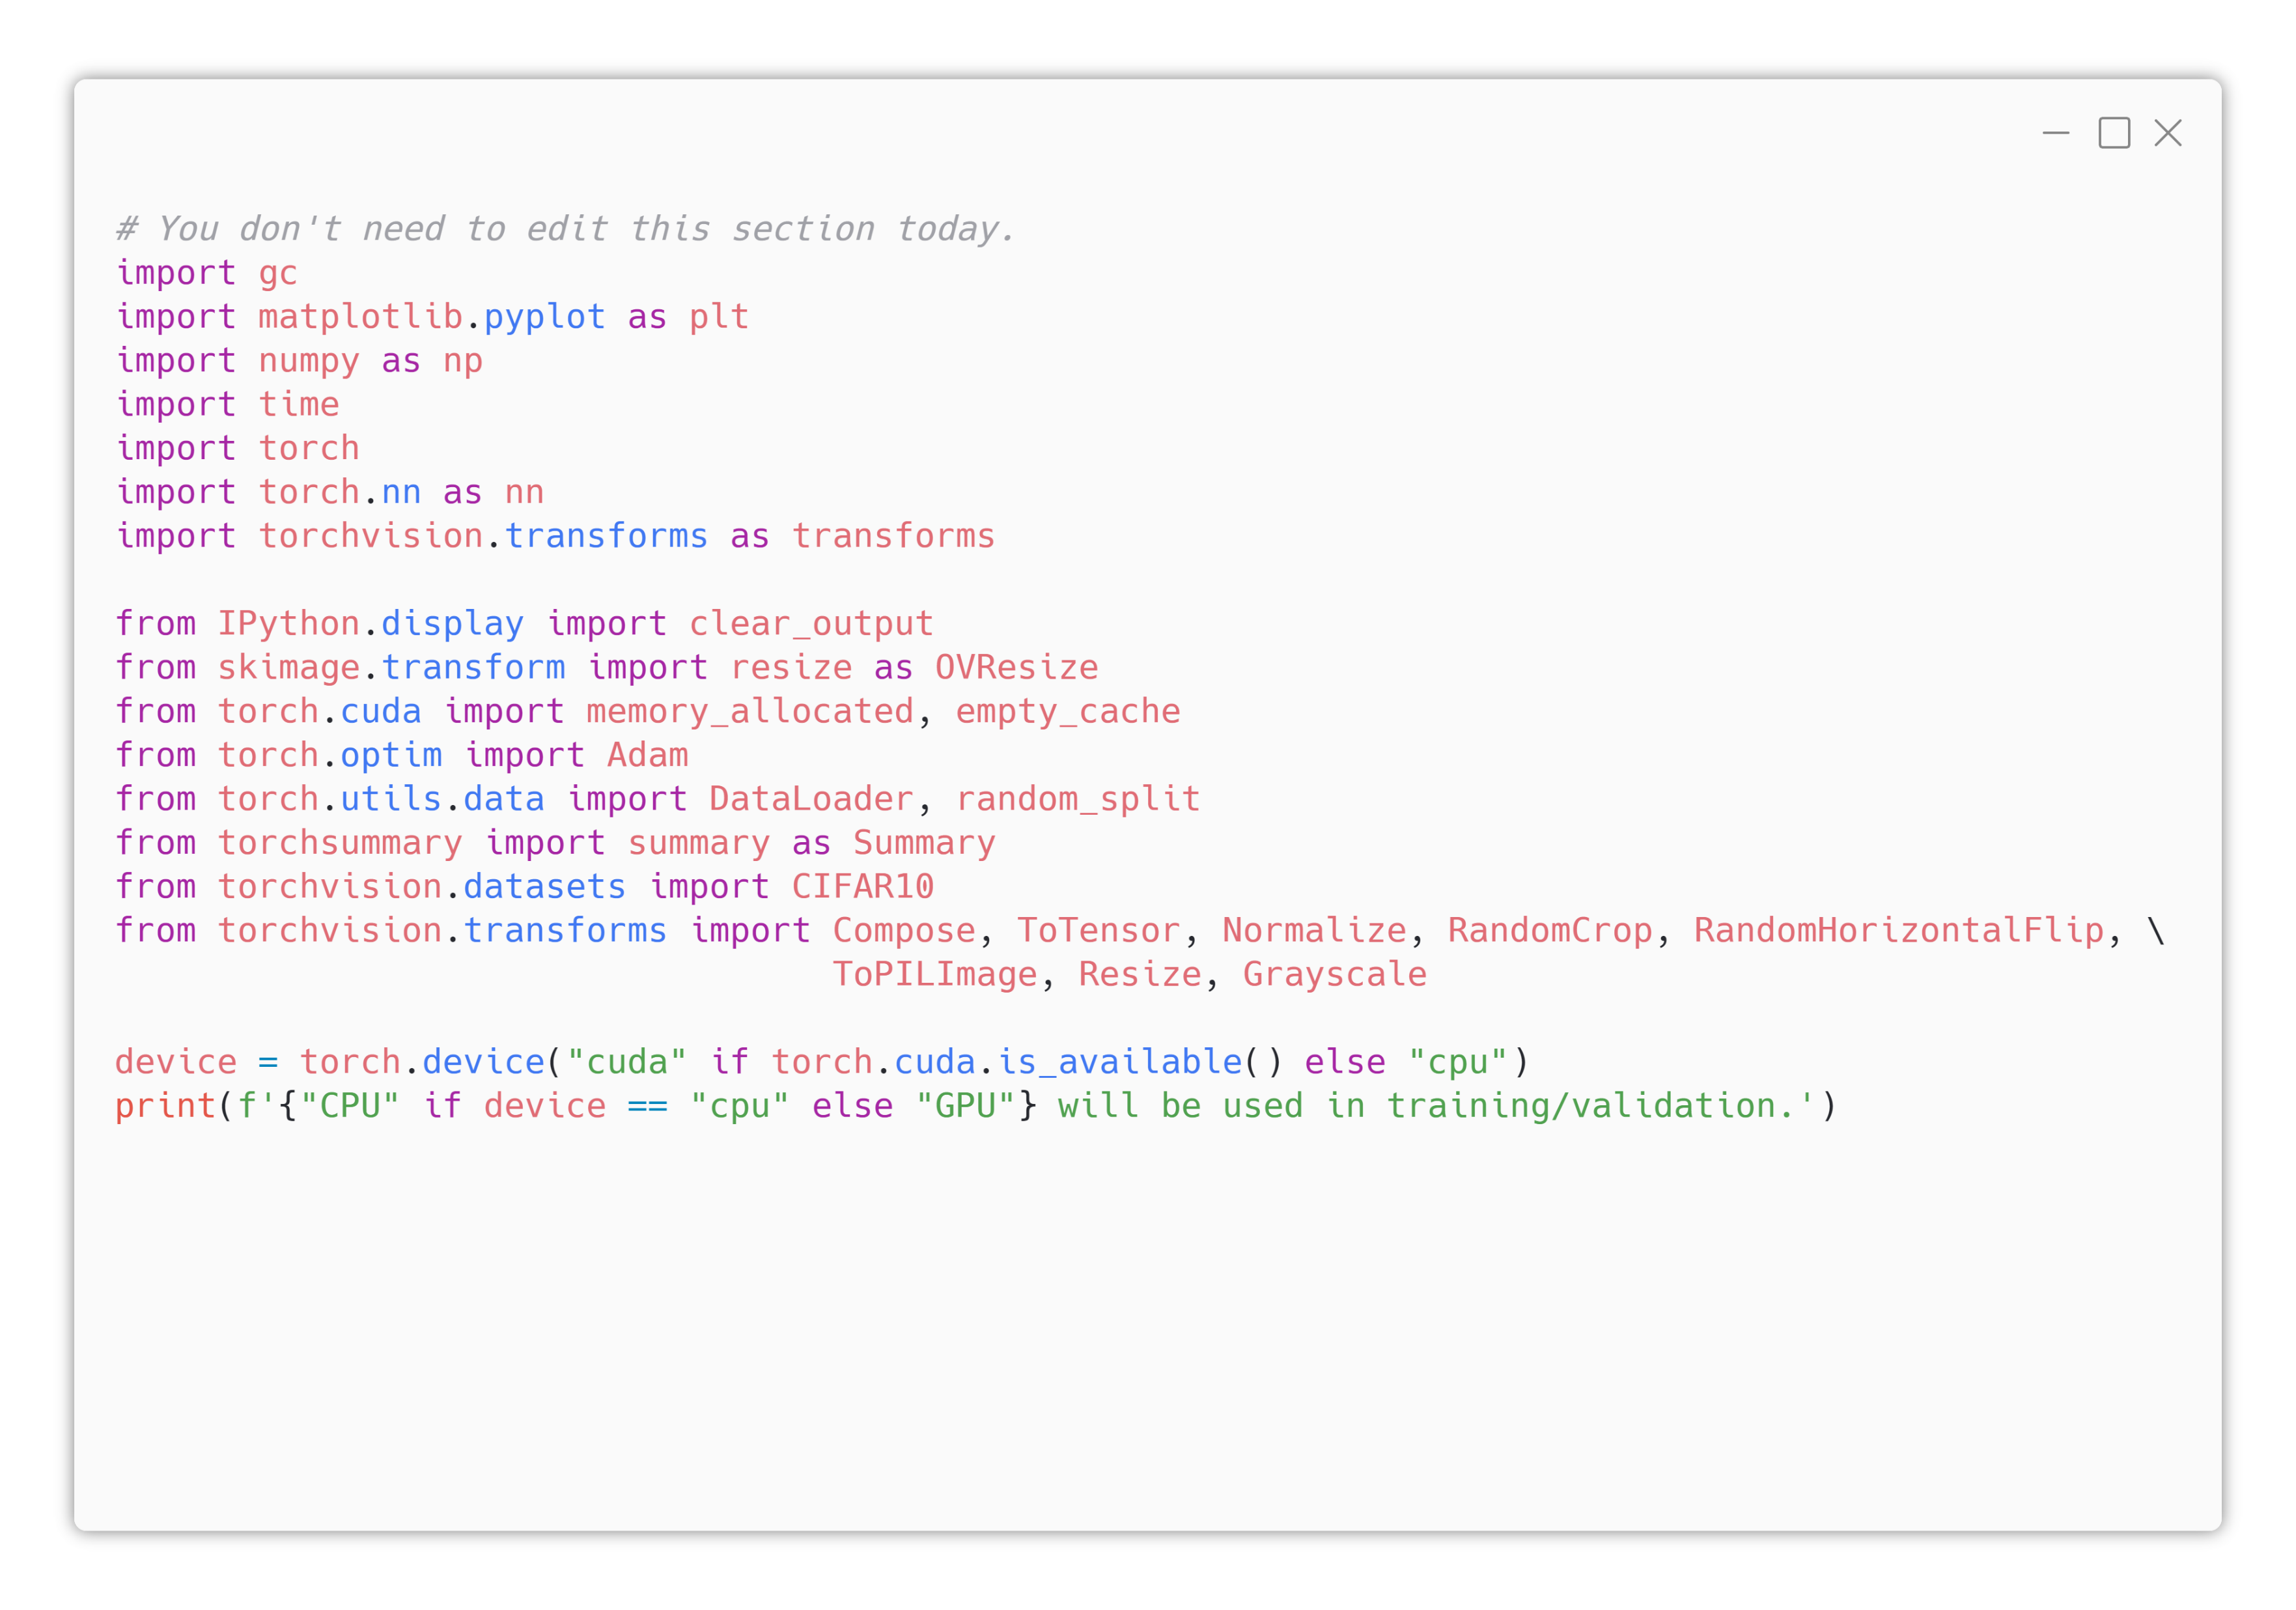

1. Lib & Dev Prep.
Already filled by TA
Today, we will use a lot of preprocessing techniques (torchvision.transforms)

Slide 16
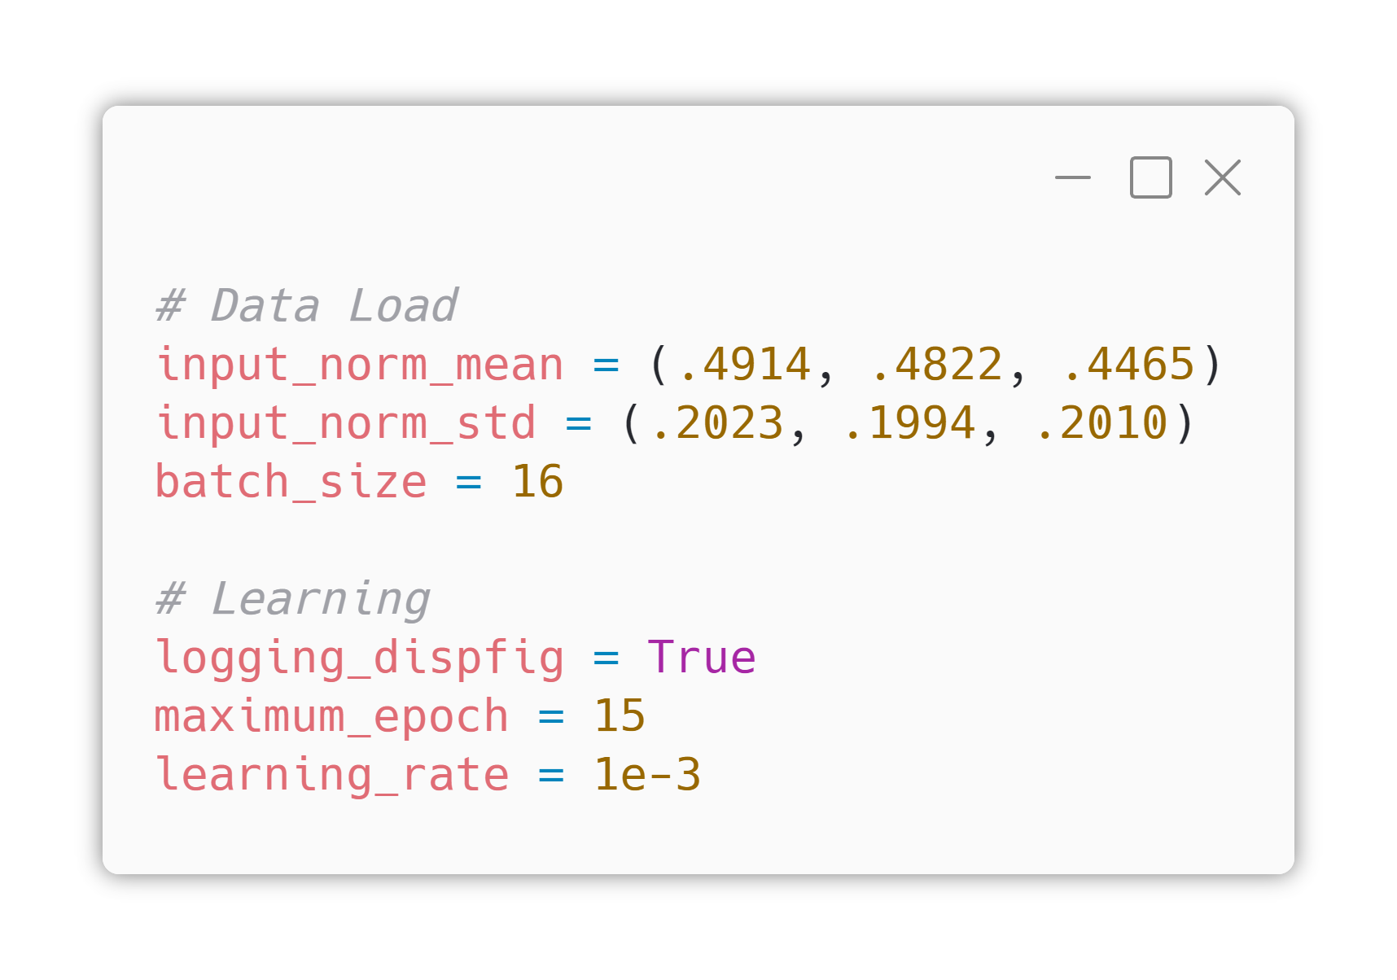
2. Hyperparams
No Model-related Hyper Parameters Today!
input_norm_mean and input_norm_std normalizes R/G/B channel to make various images be looked similarly.
Those values are fit to CIFAR-10, calculated based on computer vision theory.
Today’s batch size is small (16), because of the CUDA memory problem.

Slide 17
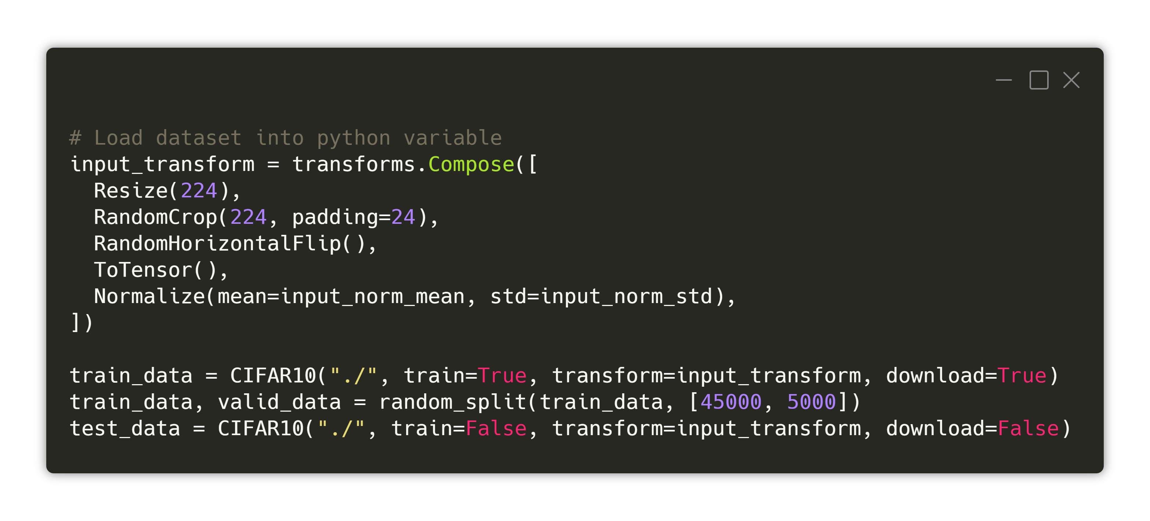
2. Hyperparams
No Model-related Hyper Parameters Today!
Today, we will use CNN model based on VGG11. VGG11 receives images with size of 224x224, so in same way, we will convert our 32x32 CIFAR10 images into 224x224 images. (“Resize(224)”)
Then we will apply data augmentation technique for more generic model. (“RandomCrop”, “RandomHorizontalFlip”)
Then we will convert our data onto Tensor and will apply RGB normalizing as I mentioned in previous slide.

Slide 18
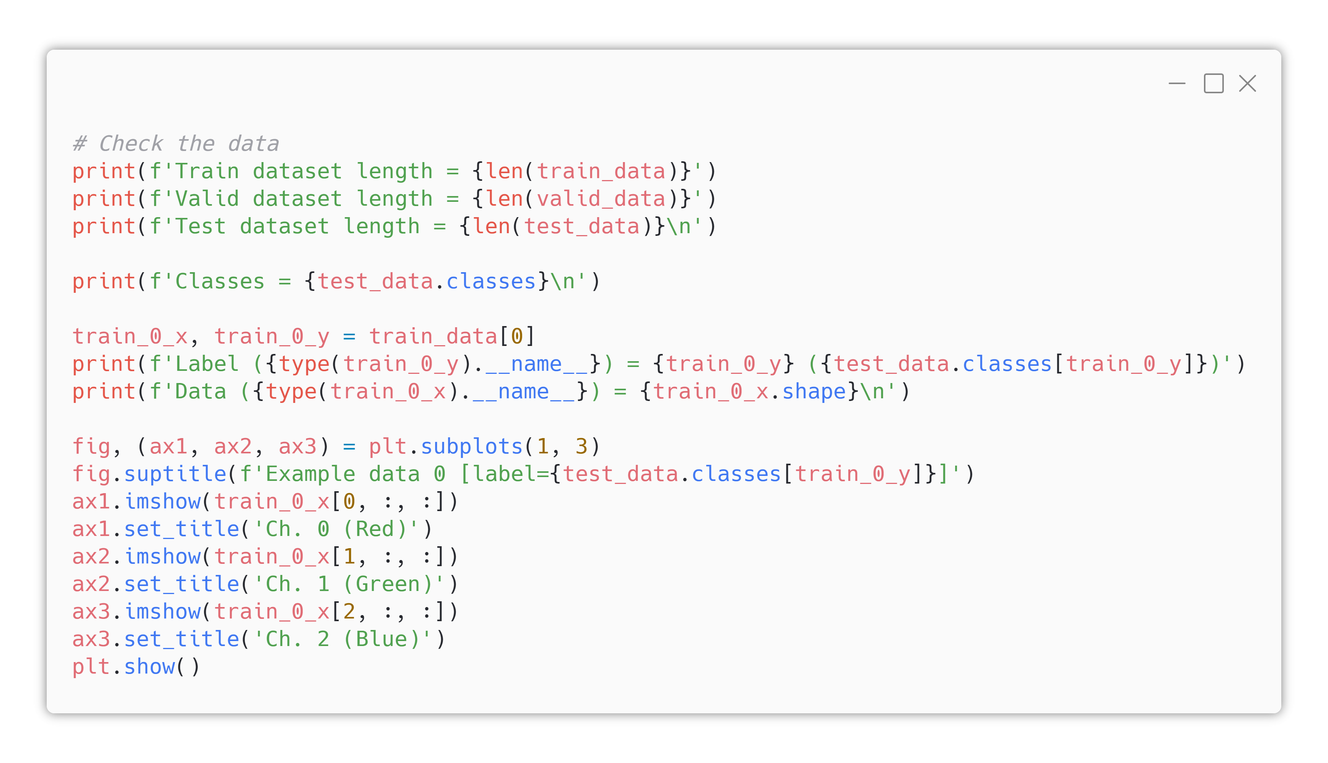
3. Data Load/Prepp.
Dataset loading
These code will show you R/G/B channel of an example image, in separated.

Slide 19
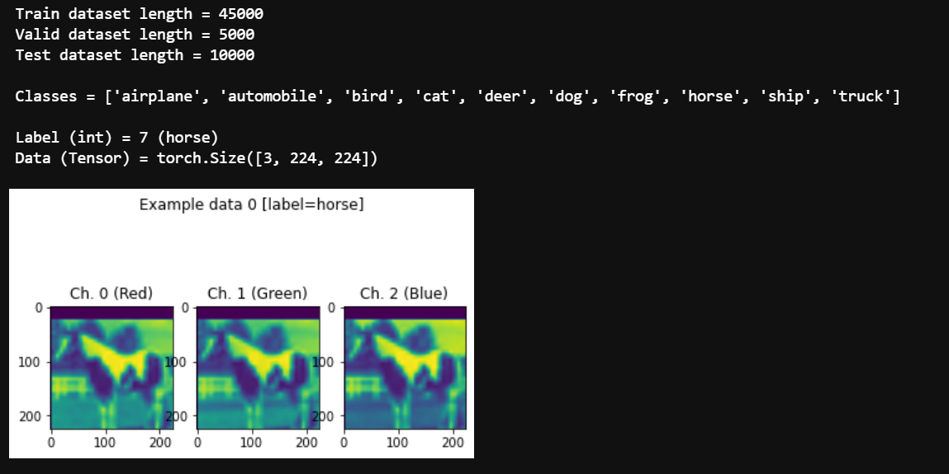
3. Data Load/Prepp.
Dataset loading
Expected Result
Look. As we applied RandomCrop, the upper part of the horse image is cropped! (empty section colored as purple).

Slide 20
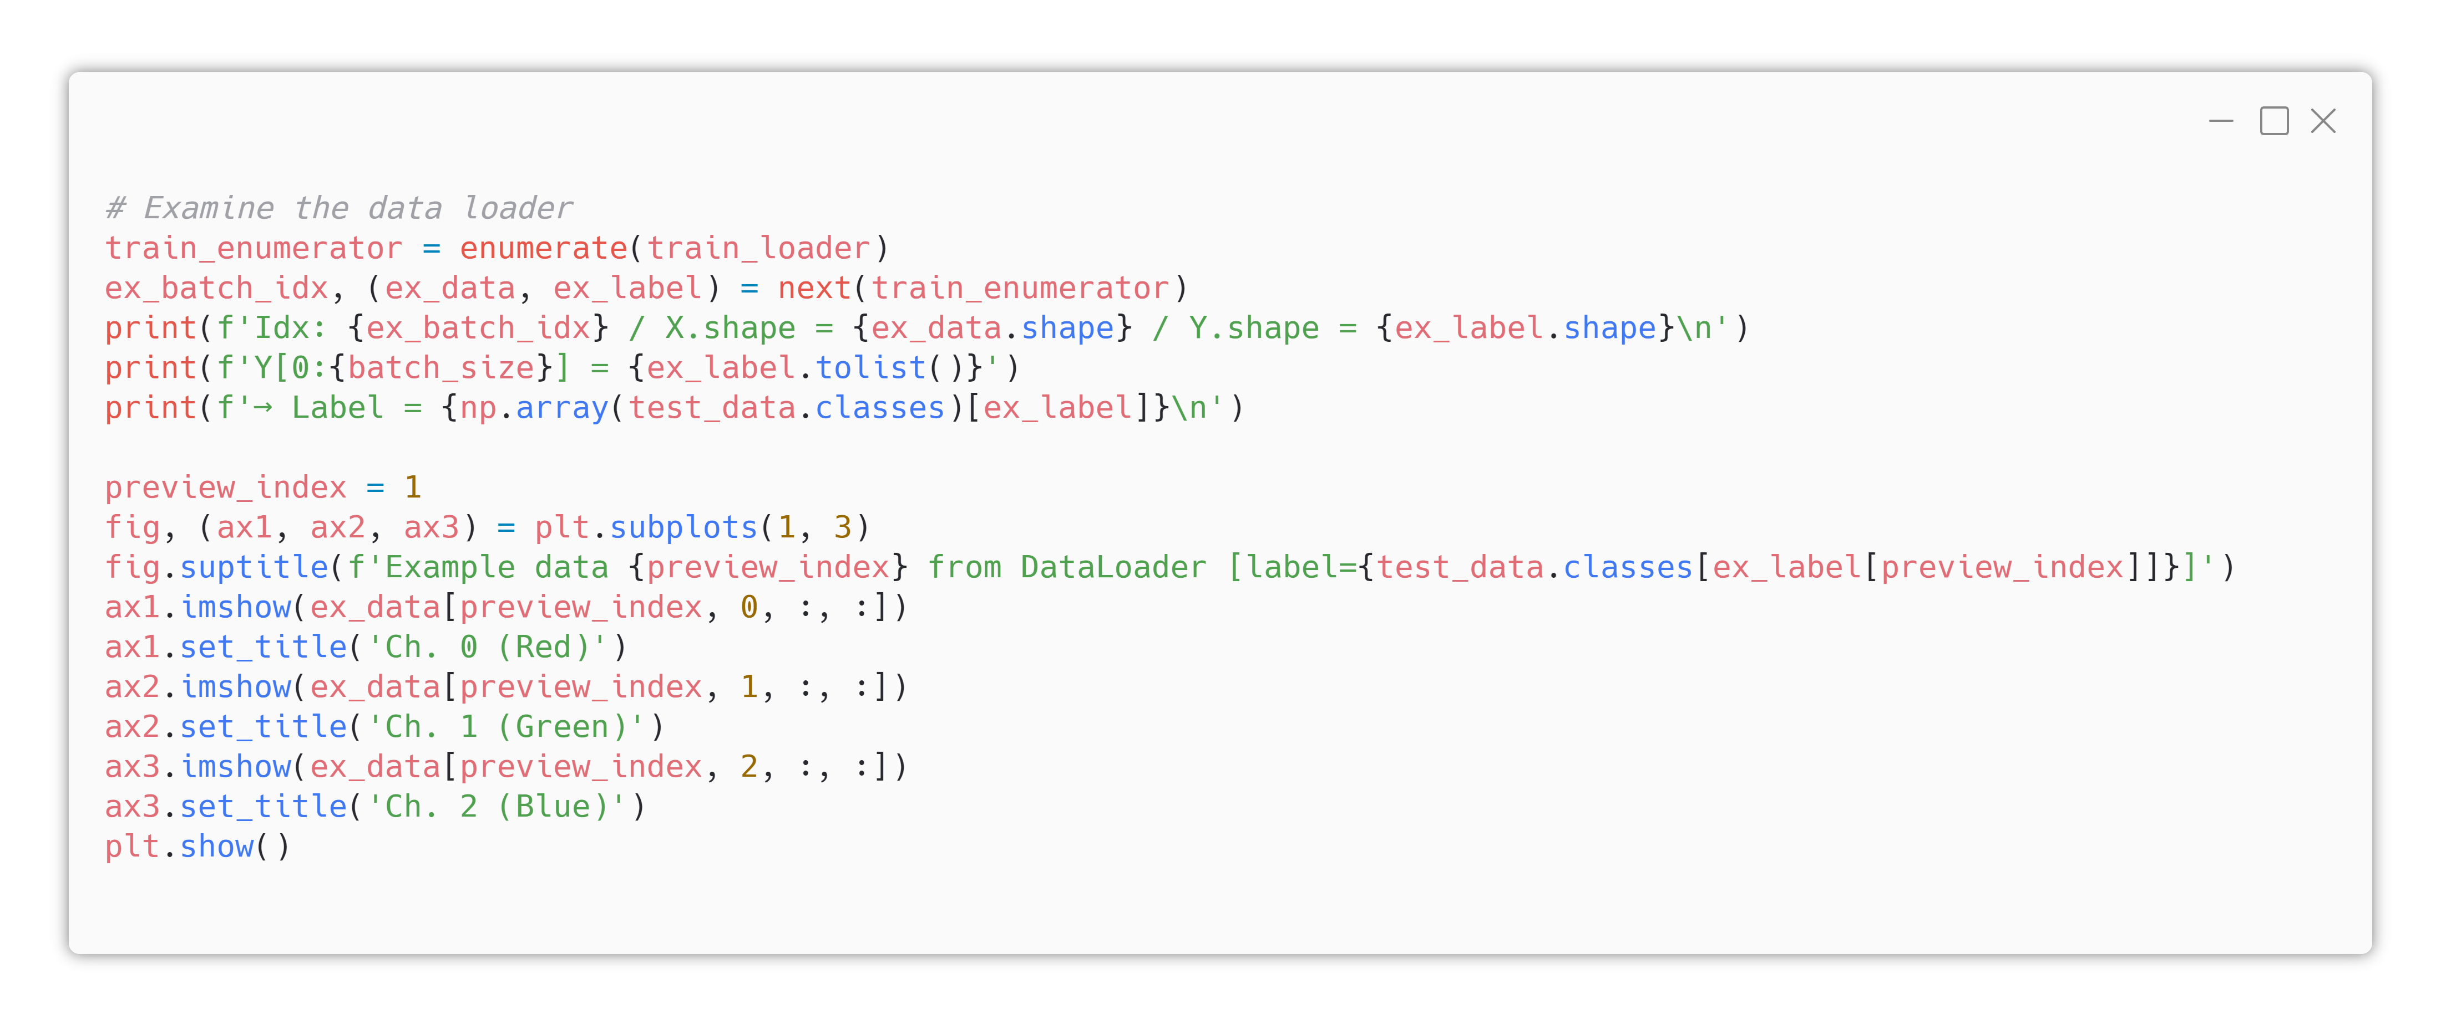
3. Data Load/Prepp.
DataLoader Wrapping

Slide 21
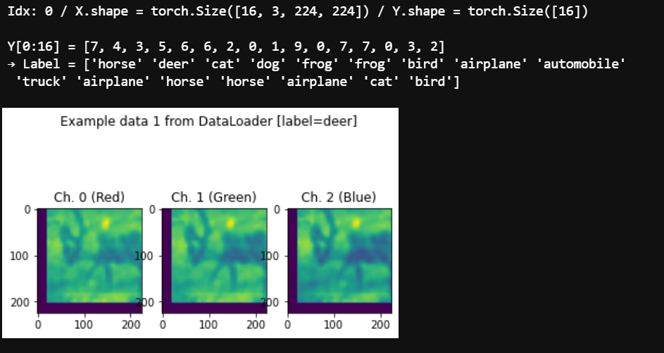
3. Data Load/Prepp.
DataLoader Wrapping
Expected Result

Slide 22
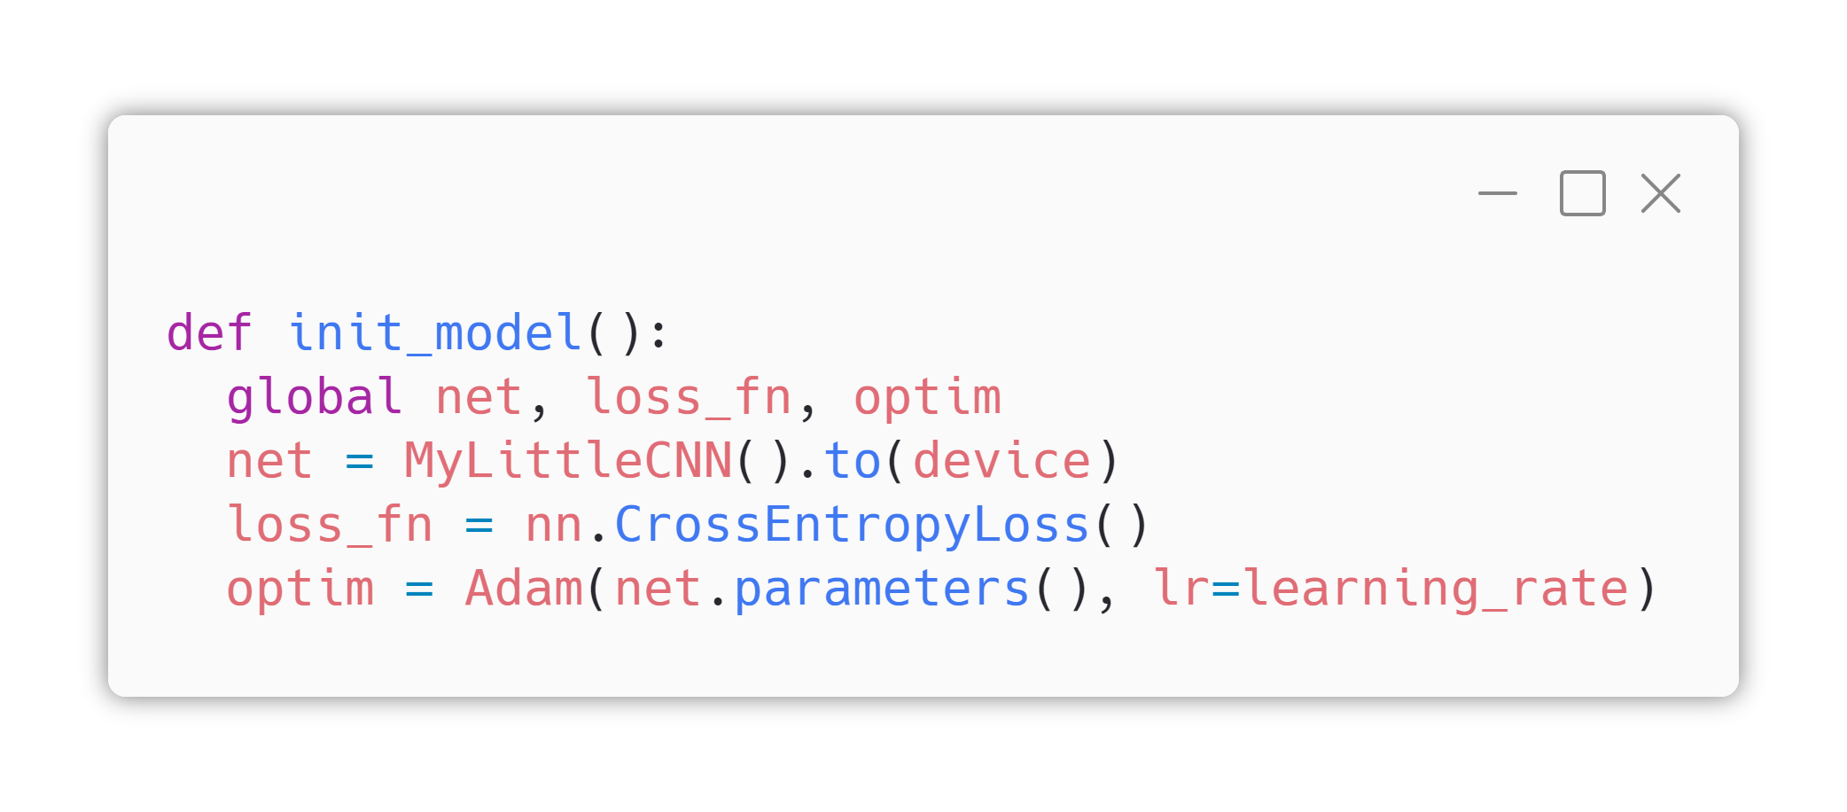
4. Fn. Definitions
Model Definition
As we did yesterday, we will define our model in class structure.
Loss function is still crossentropy
Today, we will use “Adam” optimizer, which is widely used these days instead of SGD.

Slide 23
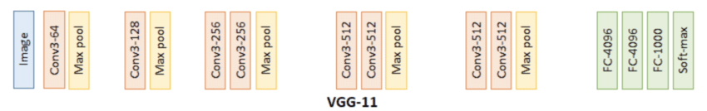
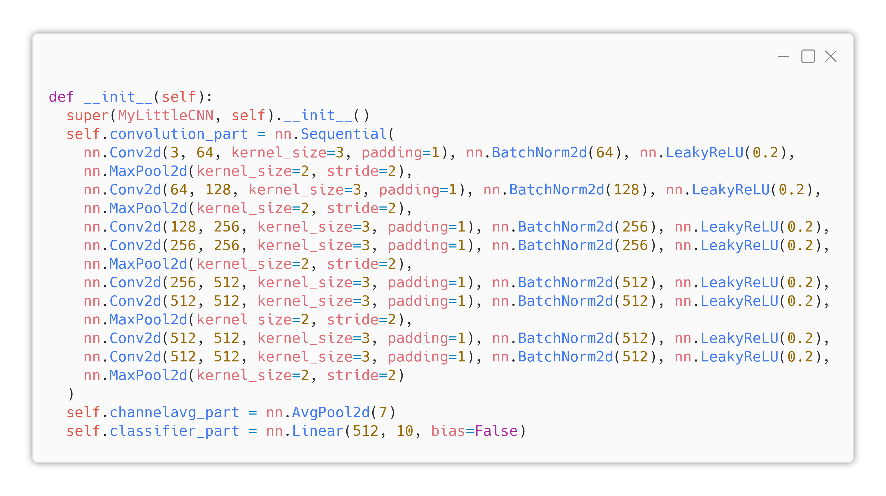
4. Fn. Definitions
Model Definition
Compare top-left VGG11 image and above code.

Slide 24
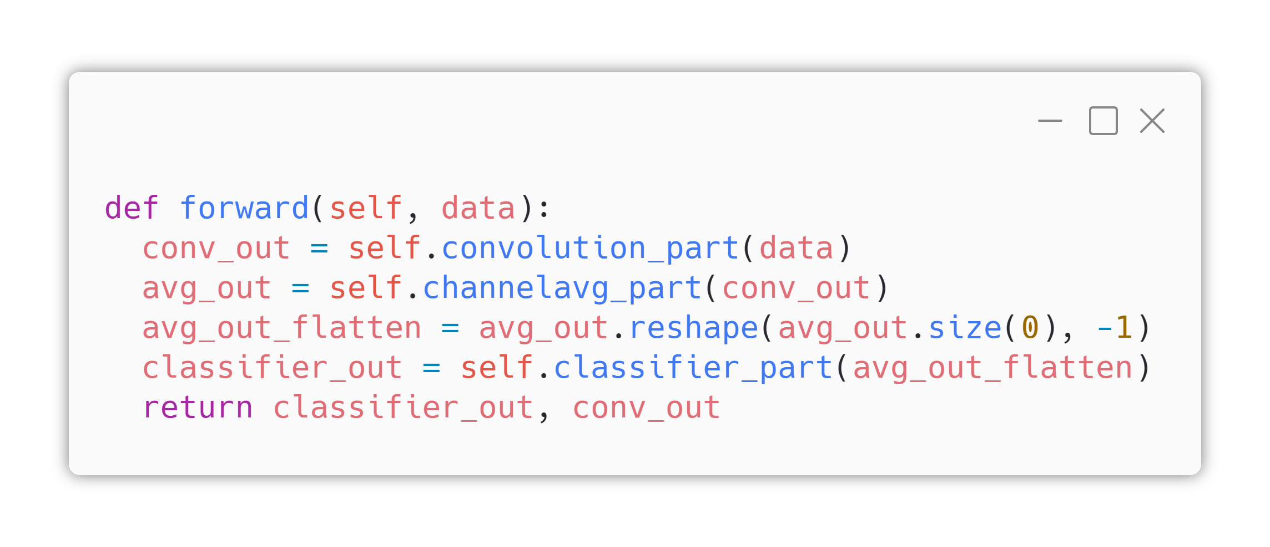
4. Fn. Definitions
Model Definition
Forward function only connects “convolution_part -> channelavg_part -> classifier_part”, with reshaping output of channelavg part and taking away convolution part output for purpose of drawing CAM.

Slide 25
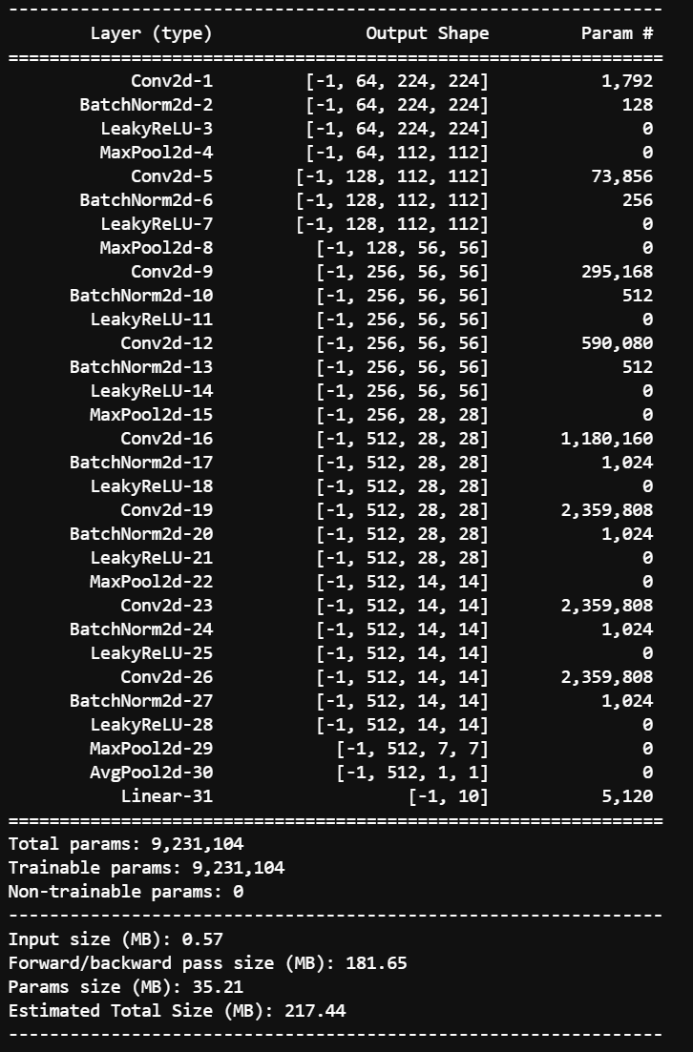
4. Fn. Definitions
Model Definition
Expected Result
Compare left TorchSummary output and below VGG 11 block diagram.

Slide 26
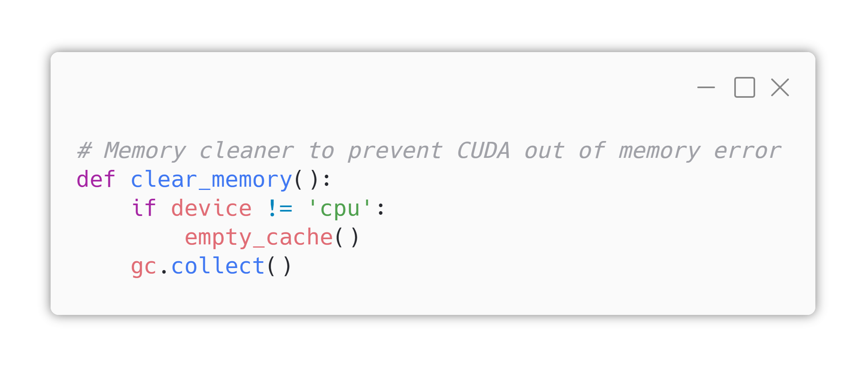
4. Fn. Definitions
GPU Memory Cleaner
Today’s model is based on VGG and VGG is very memory-intensive model. So we’re defining GPU/CPU useless cache memory cleaning function.

Slide 27
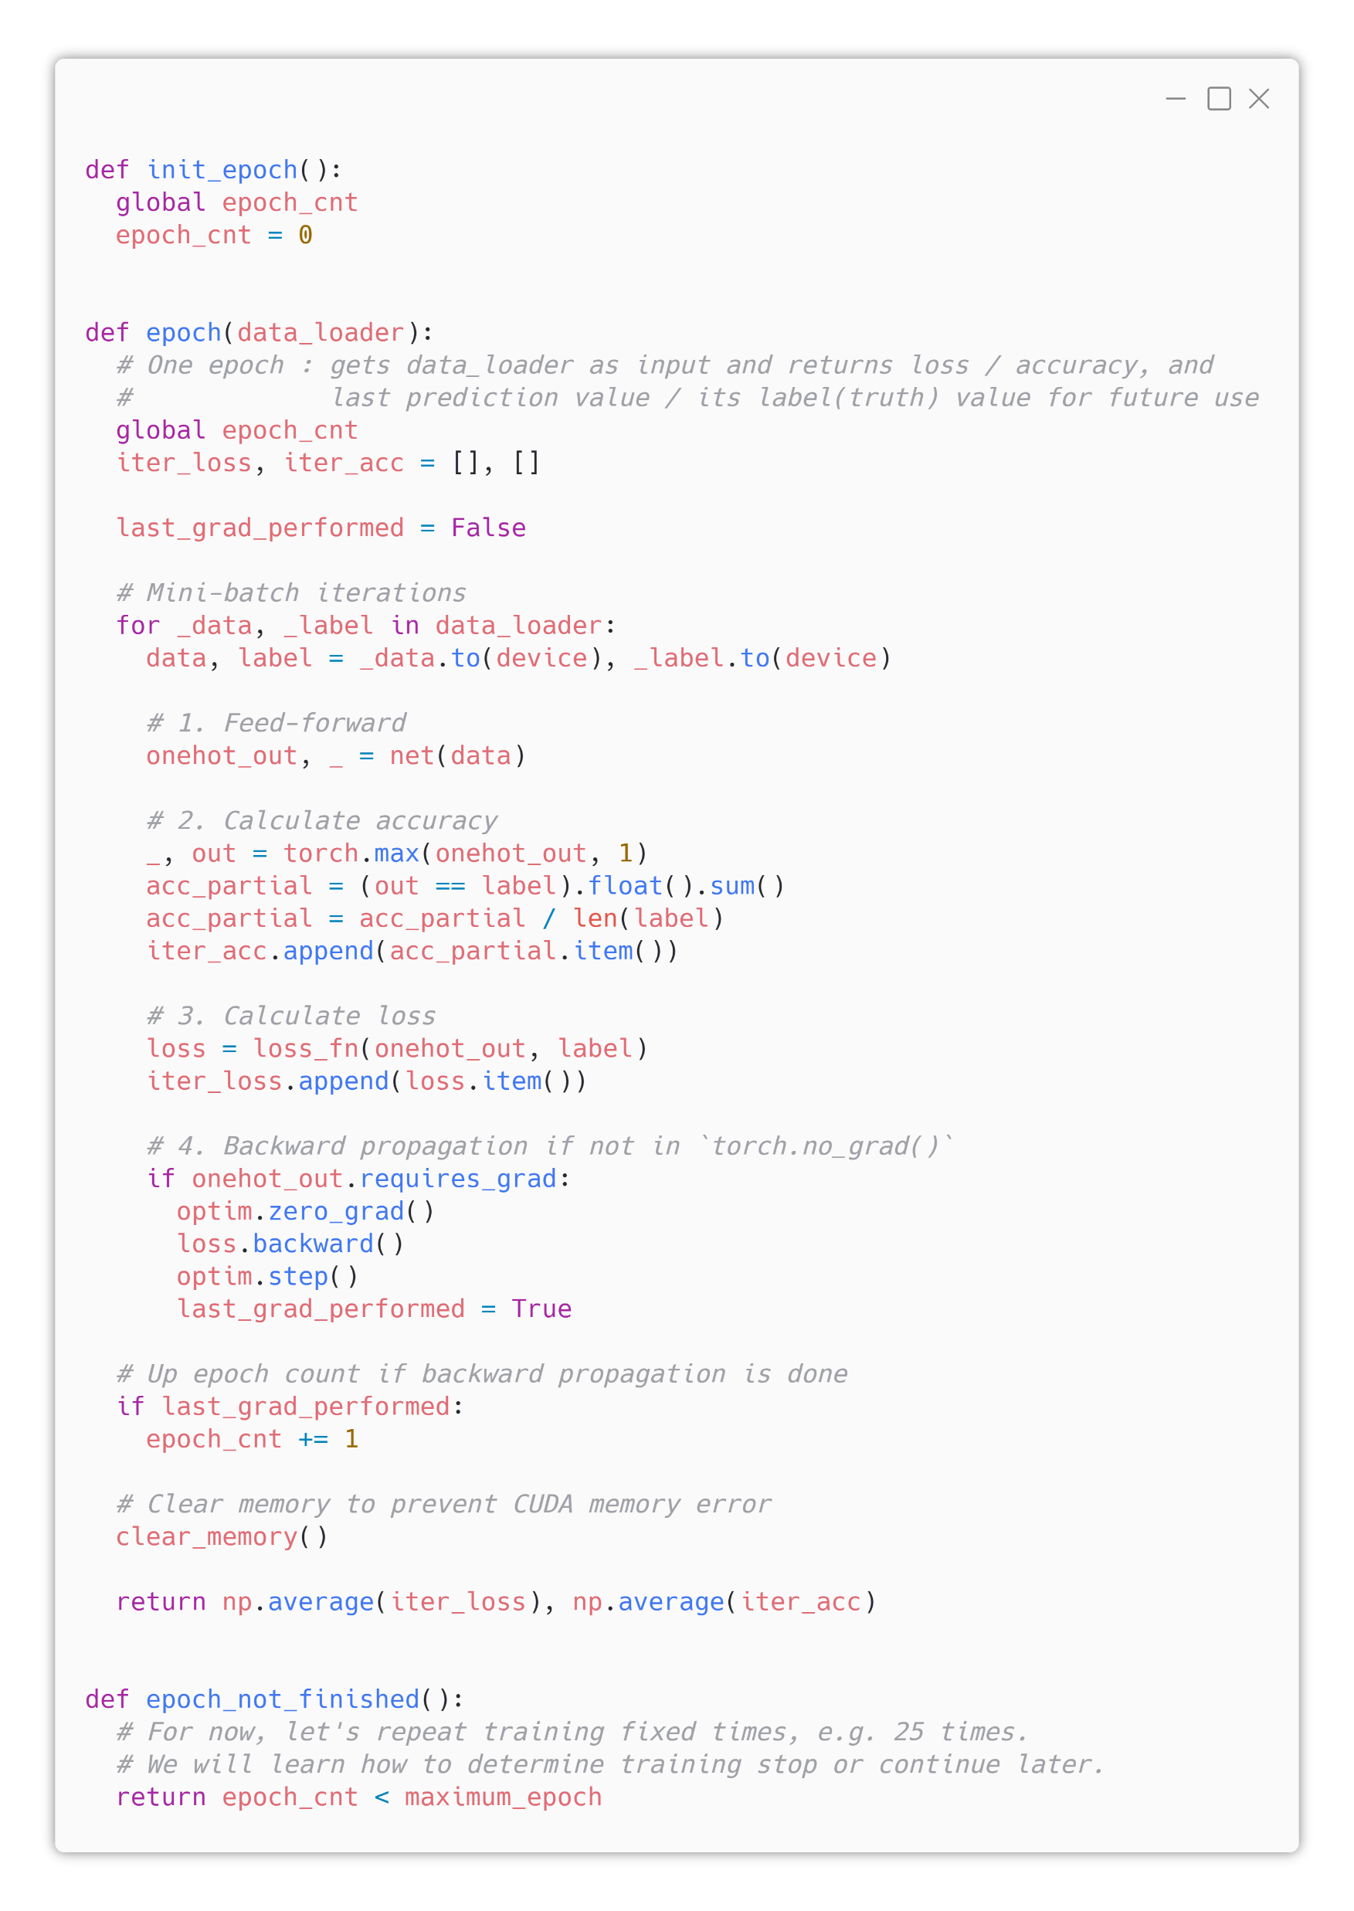
4. Fn. Definitions
Epoch Function
Filled by TA
Same as yesterday.

Slide 28
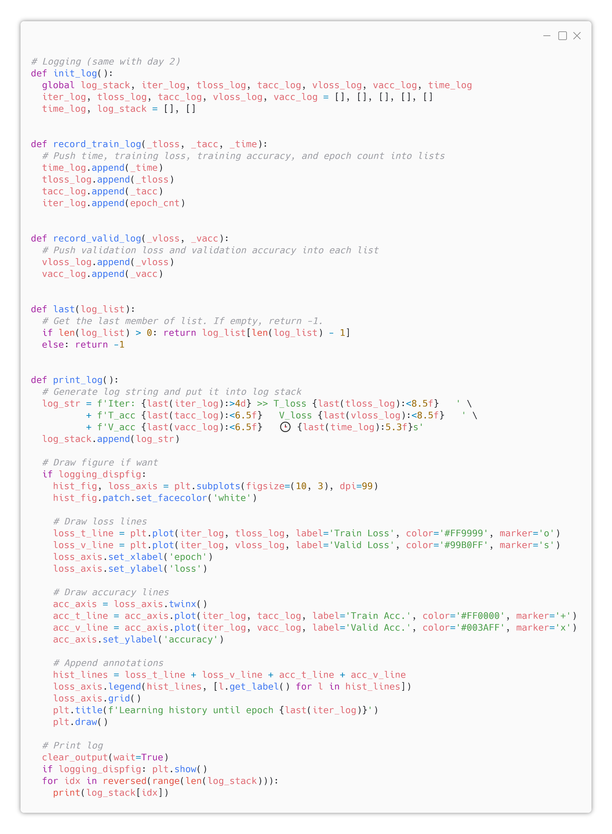
4. Fn. Definitions
Logging Function
Filled by TA
Same as yesterday.

Slide 29
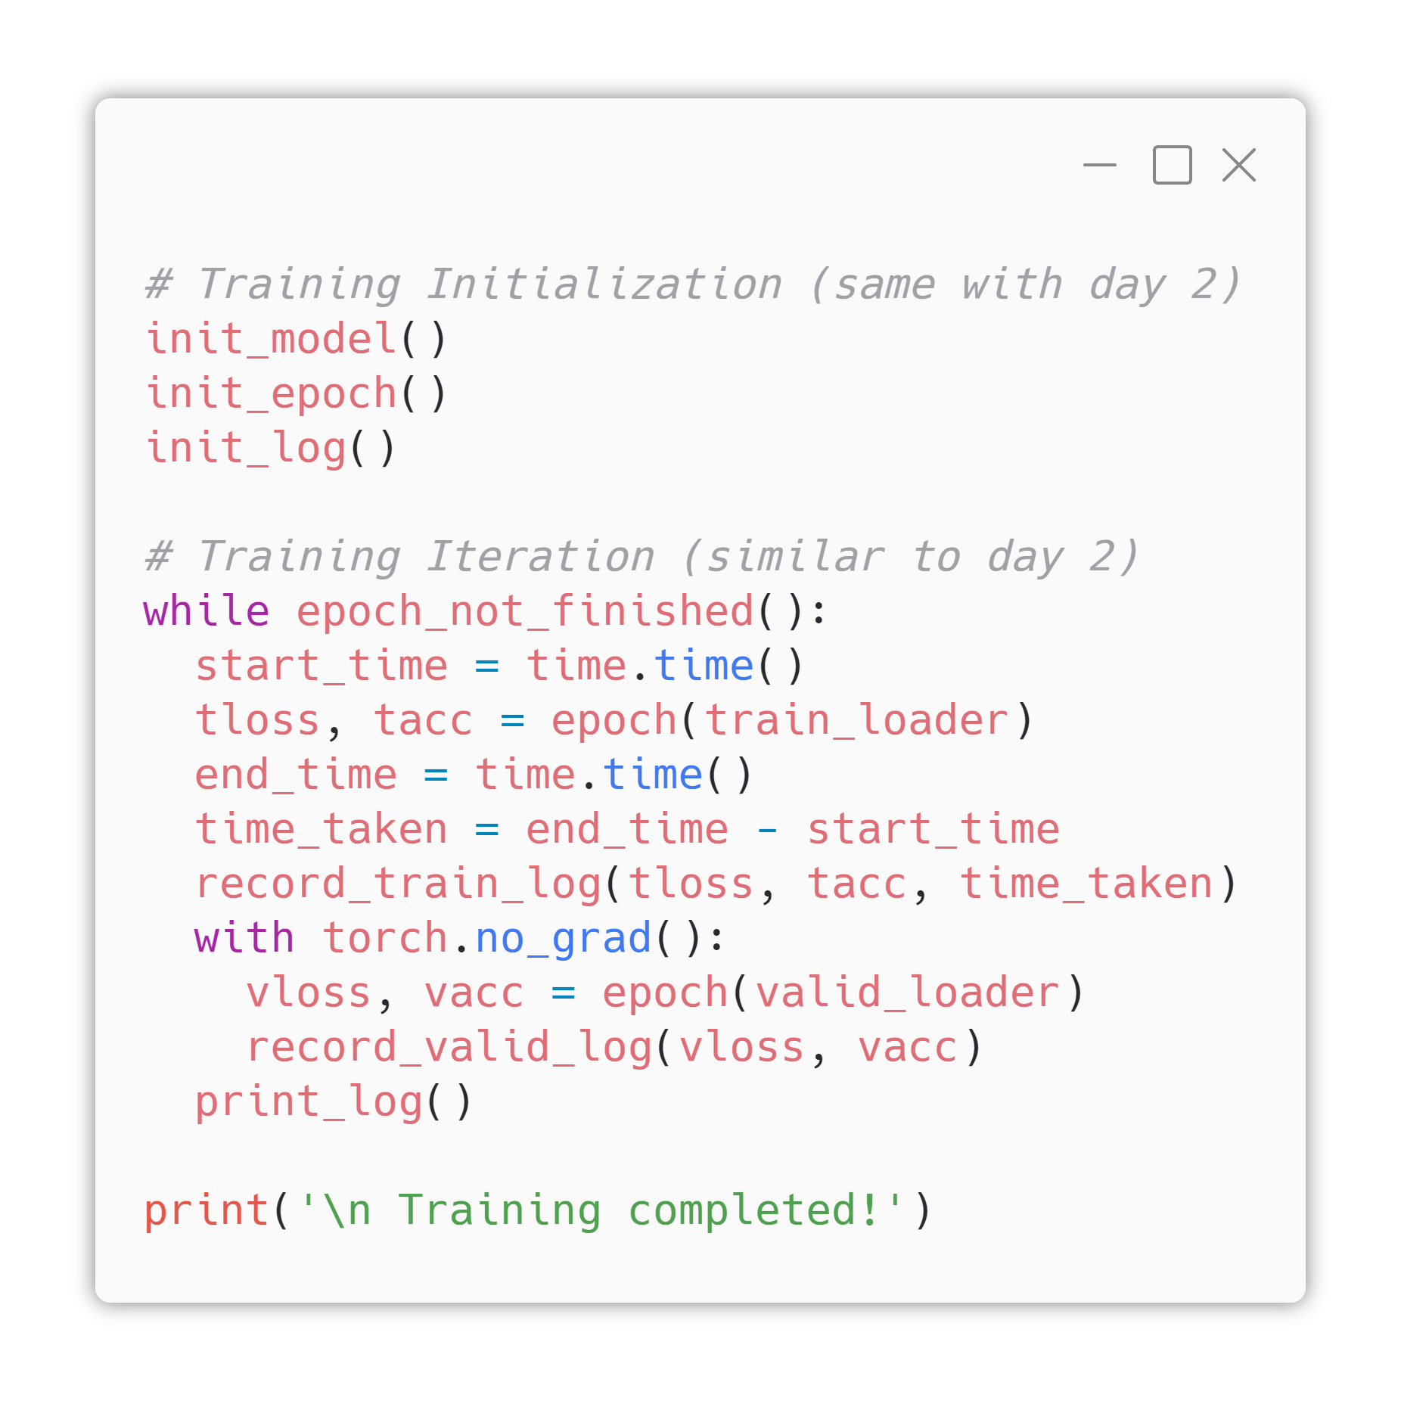
5. Training Iter.
Yeah
Filled by TA
Same as yesterday.

Slide 30
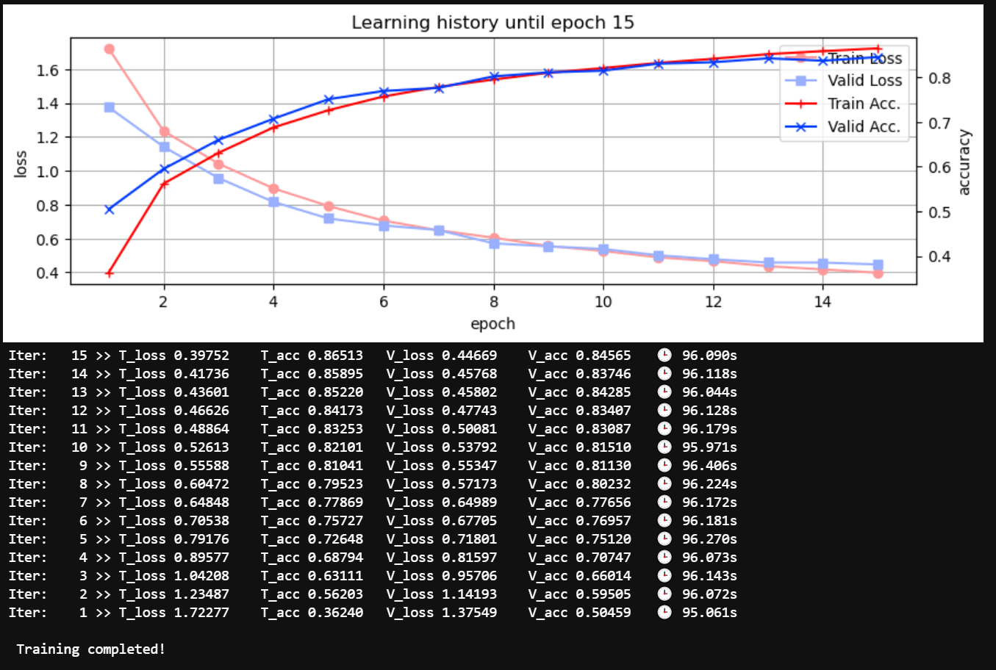
5. Training Iter.
Yeah
Beautiful graph.
Expected
Result

Slide 31
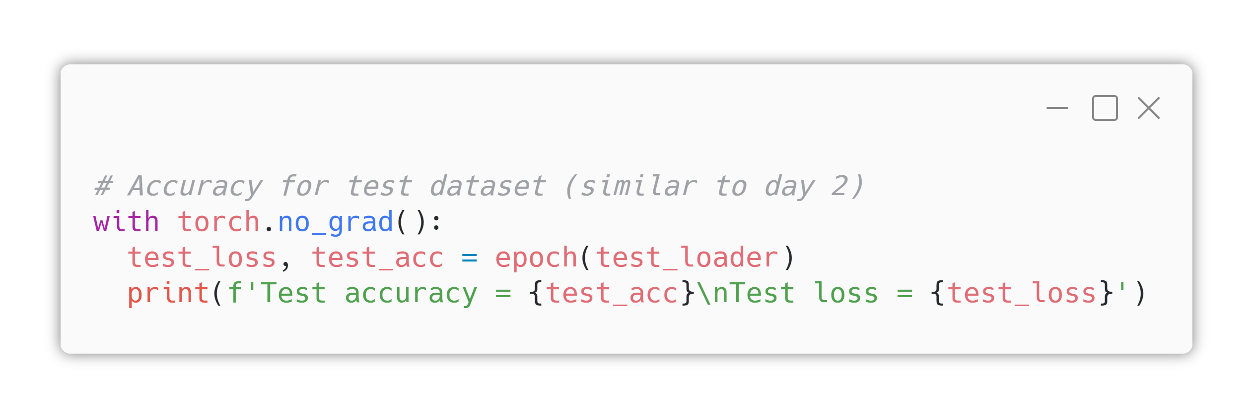
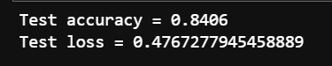
6. Result Analysis
Accuracy
Filled by TA
Expected Result

Slide 32
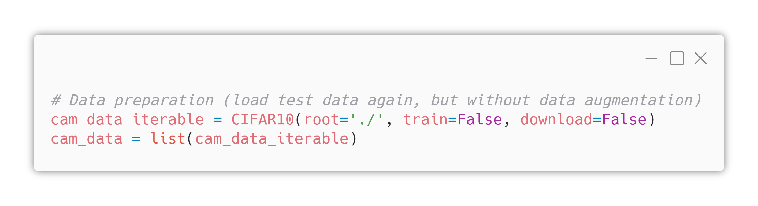
6. Result Analysis
Class Activation Map
Now we’re trying to draw class activation map (CAM).
Because we want draw the original picture and overlay CAM on it, first load image data without any transformations (first line).
Then make it as a python list (second line)

Slide 33
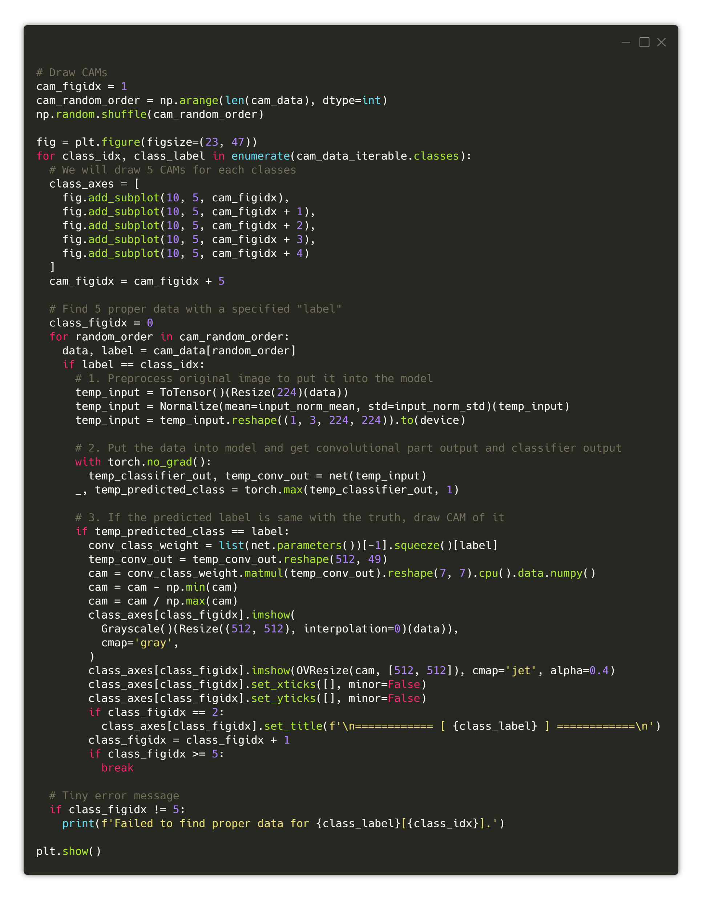
6. Result Analysis
Class Activation Map
For the full picture of “Drawing CAM” code,
Look at here : https://i.imgur.com/tlhLuS7.png
Also check for “#comments” the description.

Slide 34
6. Result Analysis
Class Activation Map
Look at here : https://laf.gg/aibd-cam

Slide 35
6. Result Analysis
Class Activation Map
Look at here : https://laf.gg/aibd-cam

Slide 36
6. Result Analysis
Class Activation Map
Look at here : https://laf.gg/aibd-cam

Slide 37
6. Result Analysis
Class Activation Map
Look at here : https://laf.gg/aibd-cam

Slide 38
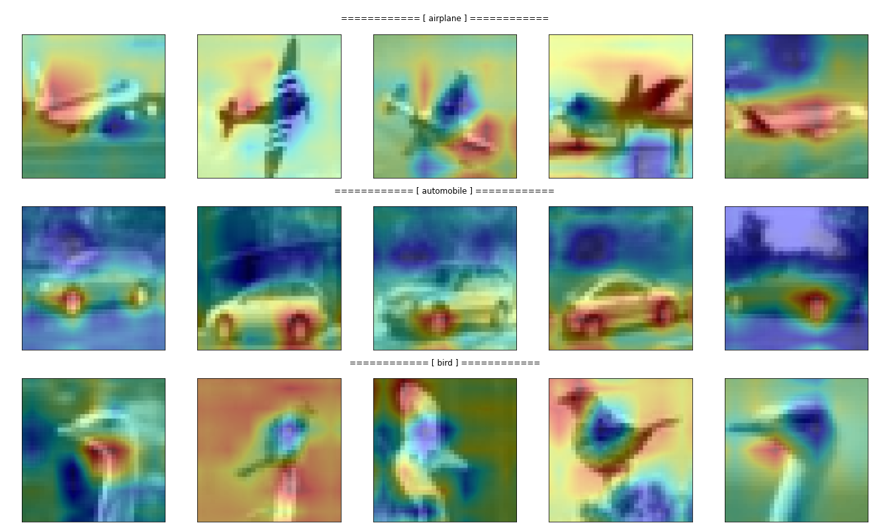
Expected
Result

Slide 39
You can check the full version of today’s .ipynb at https://git.io/aibd-full-4

